Slide 1
Synthesis- Timing Issues
CE233(CAD), Lecture 11:
Mehdi Modarressi
Department of Electrical and Computer Engineering,
University of Tehran

Slide 2
Timing of digital circuits
Timing: Setup Time and Hold Time Constraints
Q
Q’
D
CLK

Slide 3
Timing of digital circuits
A typical sequential network has both a combinational circuit and flip-flips.
Combinational
A
B
C
D
CLK
CLK

Slide 4
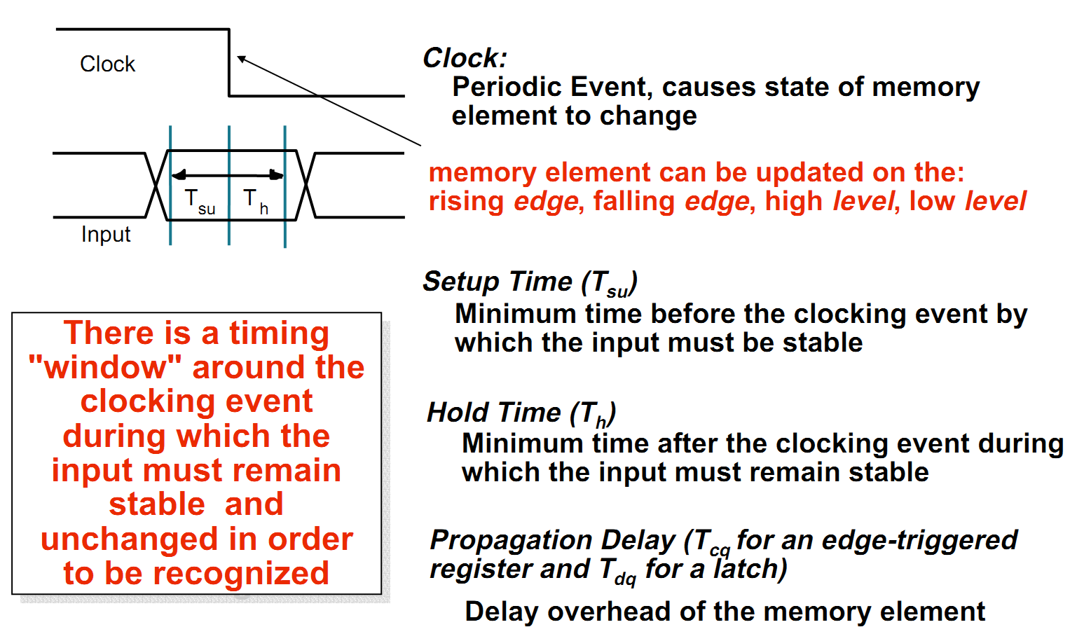
Important Timing Parameters

Slide 5
Timing of digital circuits
Combinational
A
B
C
D
CLK
CLK
tcq + tcomb + tsetup < T
thold < tcq + tcomb
Clock period
Shortest path

Slide 6
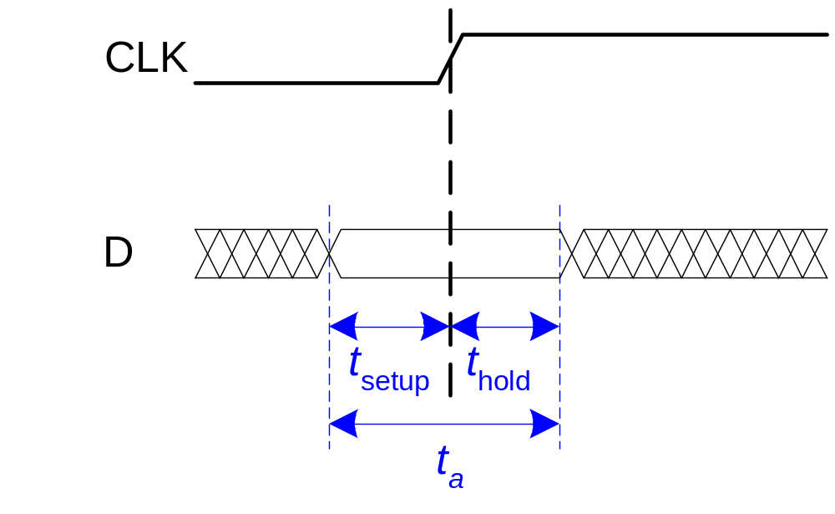
Input Timing Constraints
Setup time: t_{setup} = time before the clock edge that data must be stable (i.e. not changing)
Hold time: t_{hold} = time after the clock edge that data must be stable
Aperture time: t_{a} = time around clock edge that data must be stable (t_{a} = t_{setup} + t_{hold})

Slide 7
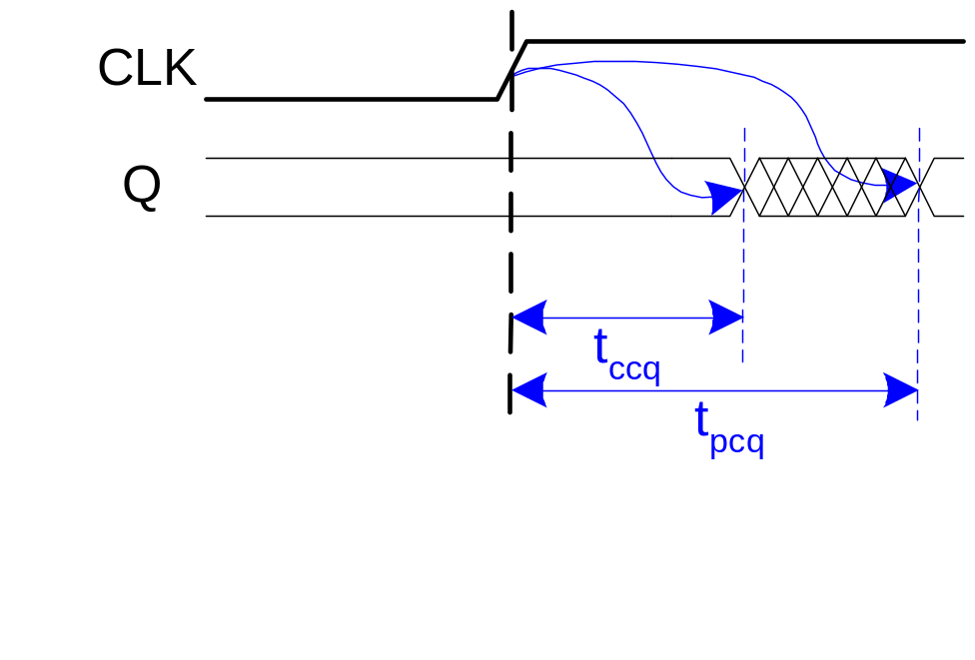
Output Timing Constraints
Propagation delay: t_{pcq} = time after clock edge that the output Q is guaranteed to be stable (i.e., to stop changing)
Contamination delay: t_{ccq} = time after clock edge that Q might be unstable (i.e., start changing)

Slide 8
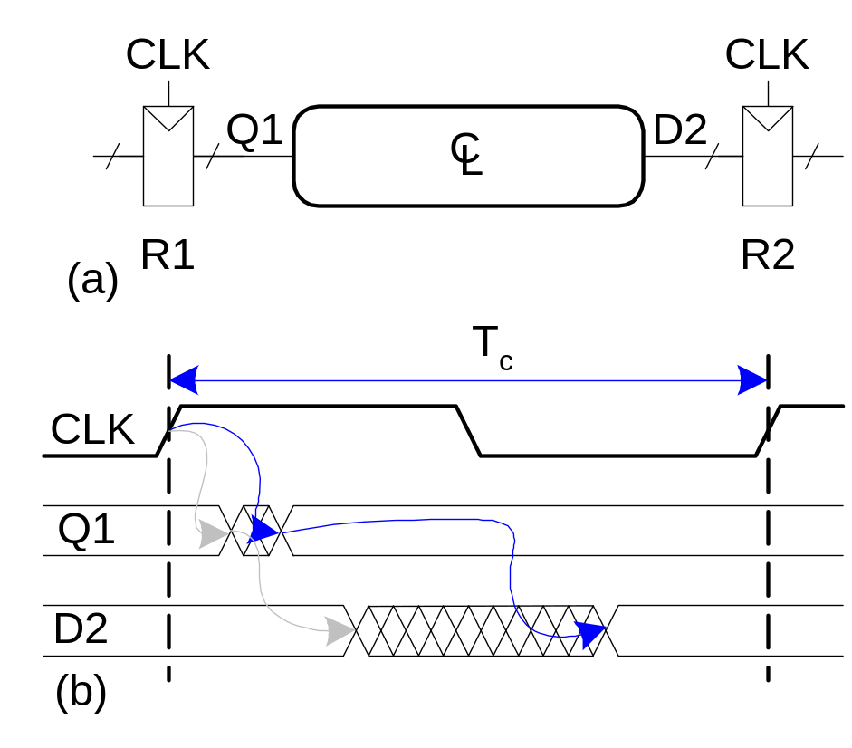
Dynamic Discipline
The delay between registers has a minimum and maximum delay, dependent on the delays of the circuit elements

Slide 9
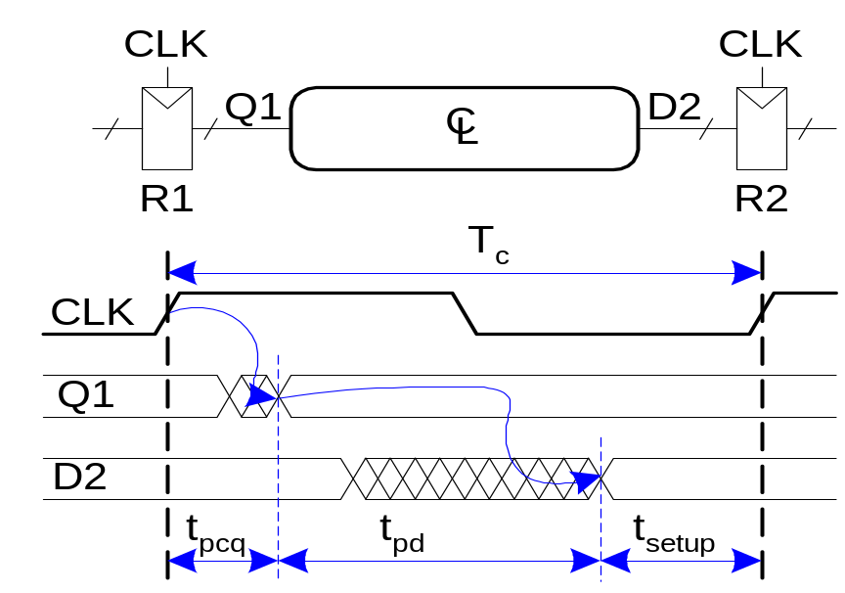
Setup Time Constraint
The setup time constraint depends on the maximum delay from register R1 through the combinational logic.
The input to register R2 must be stable at least t_{setup} before the clock edge.
T_{c} ≥ t_{pcq} + t_{pd} + t_{setup}
t_{pd} ≤ T_{c} – (t_{pcq} + t_{setup})

Slide 10
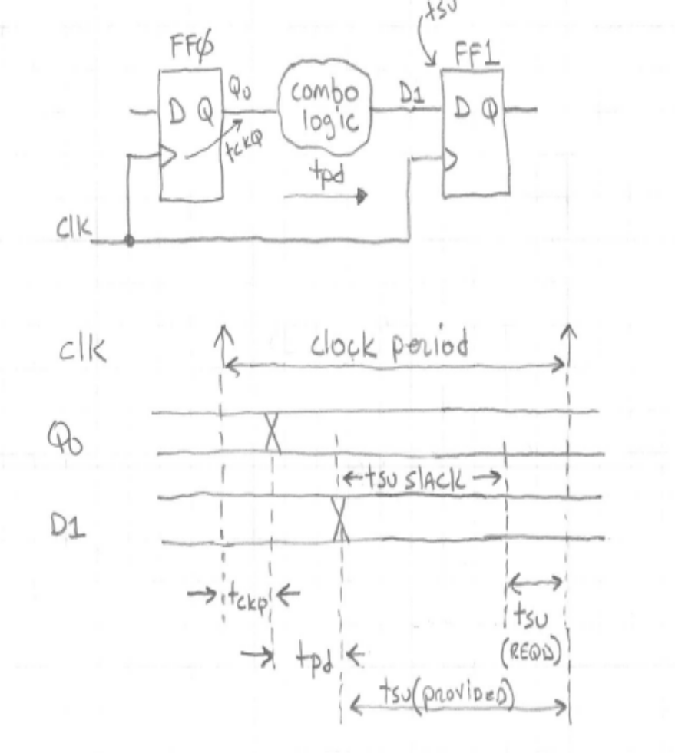
Setup time slack
The circuit provides setup time as a function of the clock period, T_{pcq} and T_{pd}
The FF requires a specified T_{setup} to operate correctly.
The difference between the two is called setup time slack.
setup time slack = (provided setup time) - (required setup time)
We always want positive slack.

Slide 11
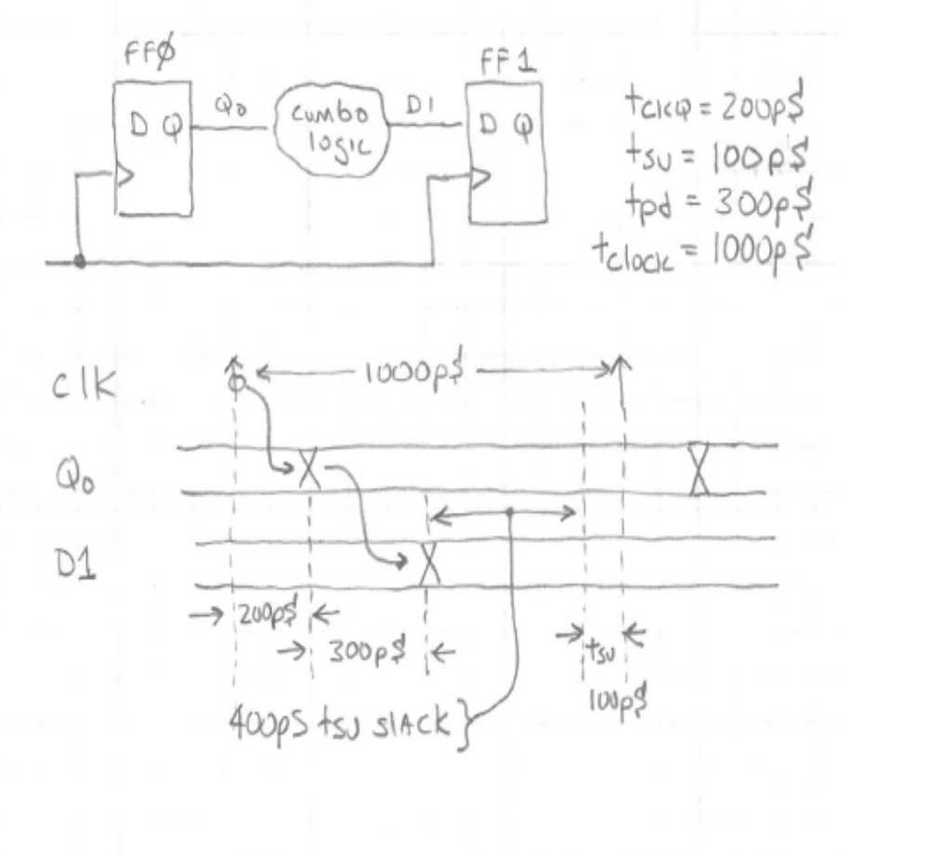
Setup time slack
example

Slide 12
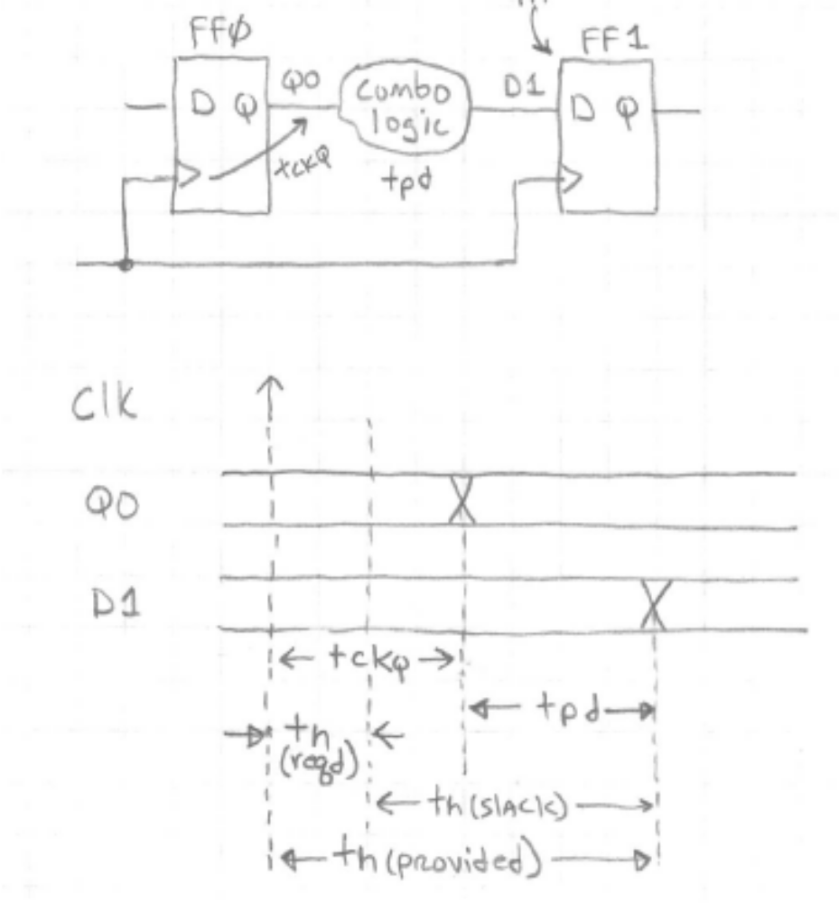
Hold time
Hold time is the amount of time that FF0’s old data must persist at the input of FF1 after the clock edge

Slide 13
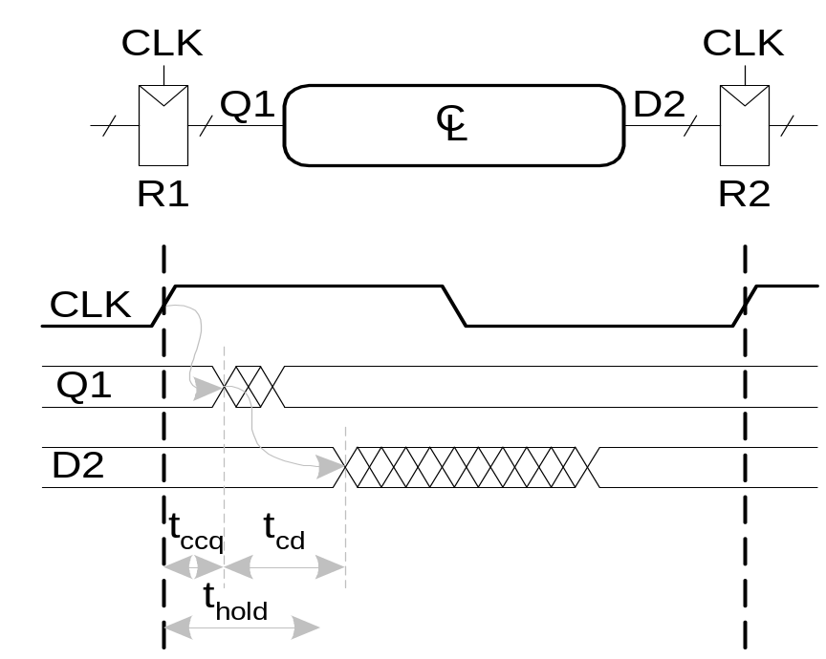
Hold Time Constraint
The hold time constraint depends on the minimum delay from register R1 through the combinational logic.
The input to register R2 must be stable for at least t_{hold} after the clock edge.
t_{hold} < t_{ccq} + t_{cd}
t_{cd} > t_{hold} - t_{ccq}

Slide 14
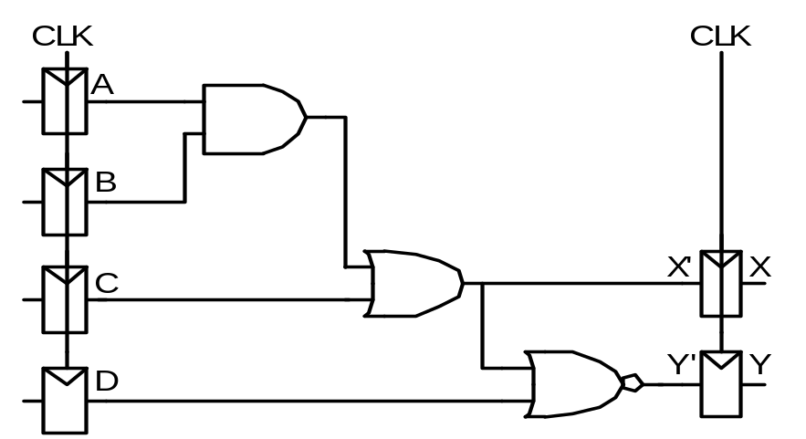
Timing Analysis
Timing Characteristics
t_{ccq} = 30 ps
t_{pcq} = 50 ps
t_{setup} = 60 ps
t_{hold} = 70 ps
t_{pd} = 35 ps (for each gate)
t_{cd} = 25 ps (for each gate)
t_{pd} =? (for whole circuit)
t_{cd} =? (for whole circuit)
Setup time constraint:
T_{c} ≥ ?
f_{c} = 1/T_{c} = ?
Hold time constraint:
t_{ccq} + t_{cd} > t_{hold} ?

Slide 15
Timing Analysis
Timing Characteristics
t_{ccq} = 30 ps
t_{pcq} = 50 ps
t_{setup} = 60 ps
t_{hold} = 70 ps
t_{pd} = 35 ps
t_{cd} = 25 ps
t_{pd} = 3 x 35 ps = 105 ps
t_{cd} = 25 ps
Setup time constraint:
T_{c} ≥ (50 + 105 + 60) ps = 215 ps
f_{c} = 1/T_{c} = 4.65 GHz
Hold time constraint:
t_{ccq} + t_{cd} > t_{hold} ?
(30 + 25) ps > 70 ps ? No!

Slide 16
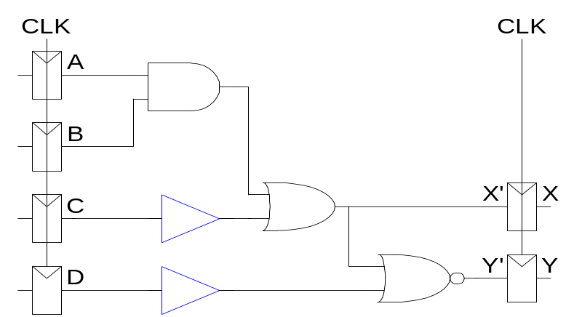
Fixing Hold Time Violation
Add buffers to the short paths:
Timing Characteristics
t_{ccq} = 30 ps
t_{pcq} = 50 ps
t_{setup} = 60 ps
t_{hold} = 70 ps
t_{pd} = 35 ps
t_{cd} = 25 ps
t_{pd} =
t_{cd} =
Setup time constraint:
T_{c} ≥
f_{c} =
Hold time constraint:
t_{ccq} + t_{cd} > t_{hold} ?

Slide 17
Fixing Hold Time Violation
Add buffers to the short paths:
Timing Characteristics
t_{ccq} = 30 ps
t_{pcq} = 50 ps
t_{setup} = 60 ps
t_{hold} = 70 ps
t_{pd} = 35 ps
t_{cd} = 25 ps
t_{pd} = 3 x 35 ps = 105 ps
t_{cd} = 2 x 25 ps = 50 ps
Setup time constraint:
T_{c} ≥ (50 + 105 + 60) ps = 215 ps
f_{c} = 1/T_{c} = 4.65 GHz
Hold time constraint:
t_{ccq} + t_{cd} > t_{hold} ?
(30 + 50) ps > 70 ps ? Yes!

Slide 18
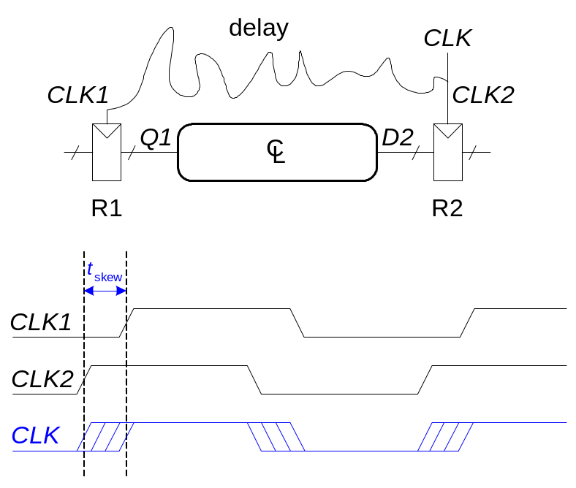
Clock Skew
The clock doesn’t arrive at all registers at the same time
Skew is the difference between two clock edges
Examine the worst case to guarantee that the dynamic discipline is not violated for any register – many registers in a system!

Slide 19
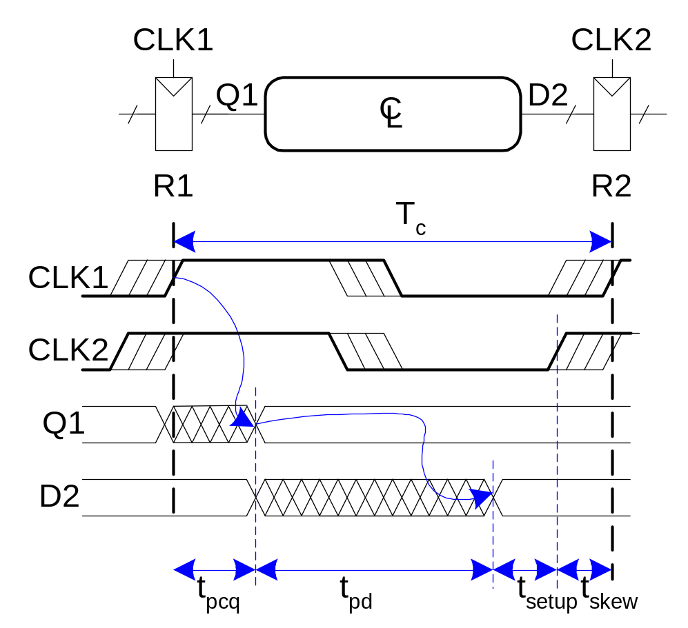
Setup Time Constraint with Clock Skew
In the worst case, the CLK2 is earlier than CLK1
T_{c} ≥ t_{pcq} + t_{pd} + t_{setup} + t_{skew}
t_{pd} ≤ T_{c} – (t_{pcq} + t_{setup} + t_{skew})

Slide 20
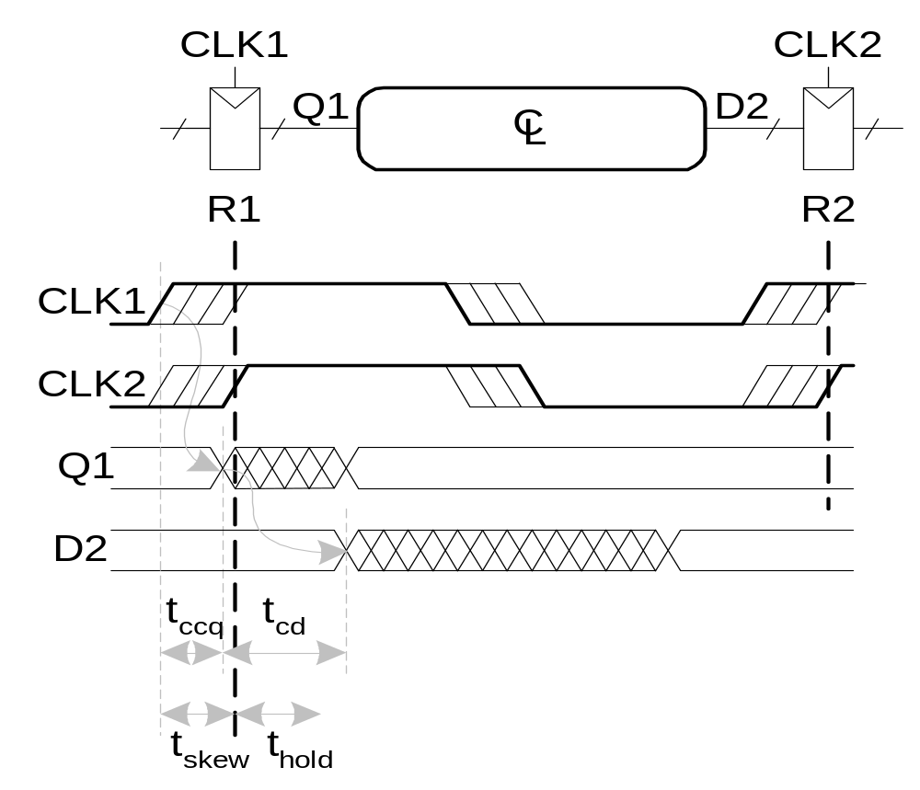
Hold Time Constraint with Clock Skew
In the worst case, CLK2 is later than CLK1
t_{ccq} + t_{cd} > t_{hold} + t_{skew}
t_{cd} > t_{hold} + t_{skew} – t_{ccq}

